Slide 1
Deep Learned Models from Medical Images: Successes and Big Challenges
Lawrence O. Hall

Slide 2
Deep learning -> Trained Deep Neural Networks
They very, very, very loosely model the human brain with neuron (nodes) and links (connections)
They have multiple (some with 150 or more) layers of neurons which are neither inputs nor outputs. They are called hidden units
Turns out the (IMHO) relatively simple backpropagation algorithm can be used to train deep networks

Slide 3
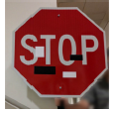
Deep Learning can learn unexpected concepts
What is the picture below?
Deep neural networks trained for use in autonomous cars call the above a 45mph Speed limit sign (https://arxiv.org/pdf/1707.08945.pdf)

Slide 4
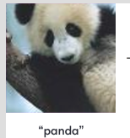
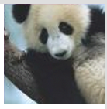
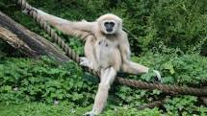
Deep Learning can learn unexpected concepts
What is the second from left picture below?
Gibbon
Real Gibbon
https://blog.openai.com/adversarial-example-research/

Slide 5

How did the CNN get confused about the Panda?

Slide 6
Case Study: Ophthalmology
Need to detect diabetic retinopathy, a leading cause of blindness
Lots of high quality image data - 120,000 retinal fundus photographs used to train a (CNN) deep neural network model
Diagnosis by direct visualization of retina by medical specialists, either via eye exam or imaging. Then grade the level of disease based on presence of characteristic lesions, indicative of blood vessel damage (hemorrhage, microaneurysms, exudates, ie: bleeding or fluid leakage)

Slide 7
Case Study: Ophthalmology
Not enough specialists to do the job, especially in some regions of the world
The trained deep neural network performs comparably to specialists in doing diagnosis
Notes:
Gulshan V, Peng L, Coram M, et al. Development and Validation of a Deep Learning Algorithm for Detection of Diabetic Retinopathy in Retinal Fundus Photographs. JAMA. 2016;316(22):2402–2410. doi:10.1001/jama.2016.17216

Slide 8
Path.AI -
Commercial product not yet FDA approved, but being used “behind the scenes in clinical trials”
It not only detects cancer cells, but rates the advancement of tumors and they also suggest lines of attack for therapy
They count the immune cells surrounding a tumor looking for properties that make them useful for the latest immunotherapies—treatments that amp up the body’s natural defenses to fight cancer.

Slide 9
Case study (Corti) Chatbot that can literally save lives
Problem: Emergency dispatchers get calls about cardiac arrest, but have to figure out the problem from stressed callers
Corti learned to recognize calls with cardiac arrest from 161,000 calls of which 2,000 were cardiac arrests

Slide 10
Case study Corti
So, how good is it?
Corti was right 93% of the time vs. 73% for people
Corti came to the answer 30 seconds before people did on average
If Corti detects Cardiac arrest it notifies the dispatcher who tells the people on site to do CPR while calling for an ambulance
it can also check addresses in the background

Slide 11
Predict Lung Cancer in the Future
Prediction of Lung Nodule Malignancy from a screening CT image by an Ensemble of models
Traditional feature extraction (Radiomics) model, Transfer Learning model and three convolutional (CNN) models for the ensemble

Slide 12
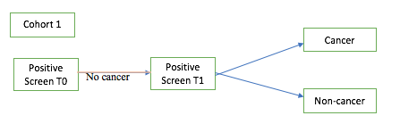
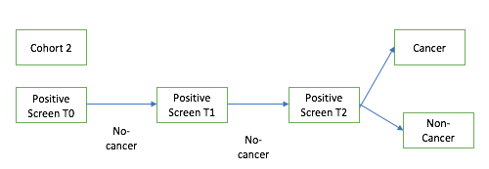
Dataset – Lung Cancer Screening Images from National Lung Cancer Screening Trial
NLST Cohort 1 (T0): Training (85 malignant and 176 nodule positive)
NLST Cohort 2 (T0): Test (85 malignant and 152 nodule positive)
Small data, but images acquired with standard protocol.
Selection of Cohort 1 and Cohort 2

Slide 13
Traditional Radiomics Features
Nodule Segmentation and feature extraction: Definiens® Software
219 radiomics features (size, texture, GLCM, etc.)
23 Rider stable features were chosen from all 219 radiomics features
Stable across two scans
Feature Selector: Symmetric Uncertainty and Classifier: Random Forests
Classification Accuracy: 76.79% (0.81 AUC) with 10 features

Slide 14
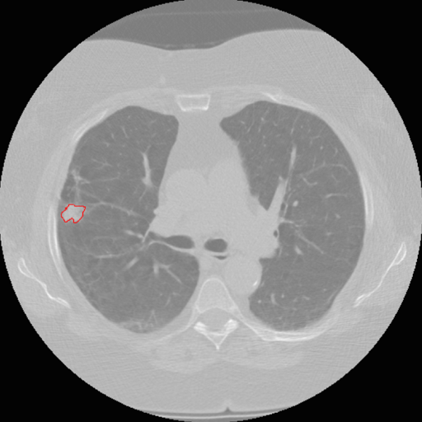
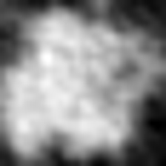
Transfer Learning
Used a convolutional Network pre-trained on ImageNet data to extract features from last fully connected layer (1024 units)
2-D approach
Chose the slice with largest nodule area for each patient case.
Nodule region was extracted by putting a rectangular box around the nodule that completely fit the nodule.
Lung image with nodule inside outlined by red and extracted nodule

Slide 15
Transfer Learning (continued)
Vgg-s pre-trained CNN was used
Color Channel : RGB (Used all color channels of the pre-trained CNN)
Concatenated the 2-D nodule image three times to make it similar in number of bits/channels of pre-trained CNN
Feature Selector: Symmetric Uncertainty and Classifier: Random Forests
Classification Accuracy: 75.1% (AUC 0.74) with 15 features

Slide 16
Convolutional Neural Network
Data augmentation on Cohort 1: 15 degree rotation and flipping (horizontally and vertically)
Learning rate: 0.0001; Input Image size: 100x100
70% of the augmented data was used for training and 30% for validation
Cohort 2 was used to test the best validated model
Notes:
Designed in Keras with Tensorflow backend

Slide 17
CNN architectures
3 CNN architectures were proposed
Classification using CNN architecture 1: 75.1% (AUC 0.82)
Classification using CNN architecture 2: 75.5% (AUC 0.86)
Classification using CNN architecture 3: 76 (AUC 0.87)

Slide 18
Ensemble Approach
Three Ensemble Combination Approaches: Voting, Average, Median
Three subsets of classifiers were created for different ensembles
Subset 1: 3 CNN architectures
Subset 2: Best CNN model, Radiomics and transfer learning models
Subset 3: All 5 models

Slide 19
Ensemble Approach (Continued)
Subset 3: All 5 models
Approach | Average | Median | Voting
Accuracy | 89.02 | 84.81 | 89.45
Accuracy significance (compared with 76.79% from traditional features) | Significant at p<0.05 | Significant at p<0.05 | Significant at p<0.05
AUC | 0.96 | 0.94 | 0.85
AUC significance (compared with AUC 0.87 of CNN architecture 3) | Significant at p<0.05 | Significant at p<0.05 | NA

Slide 20
Challenges
Medical image data is often
Hard to curate
Small in number at any given institution
Difficult to share due to laws and fiscal value
Obtained with distinctive imaging settings which might lead to learning the setting or device
Resulting in models that are opaque (we do not know what was learned and how trustworthy it is or what failure modes might be)
Two examples of failures of deep learned medical models
Pneumonia diagnosis from chest X-ray (CXR) images and
COVID-19 diagnosis from chest X-ray images

Slide 21
Variable generalization performance of a deep learning model to detect pneumonia in chest radiographs: A cross-sectional study. PLOS med. 2018
158,323 chest radiographs from three institutions: National Institutes of Health Clinical Center (NIH; 112,120 from 30,805 patients), Mount Sinai Hospital (MSH; 42,396 from 12,904 patients), and Indiana University Network for Patient Care (IU; 3,807 from 3,683 patients)
These patient populations had an age mean (SD) of 46.9 years (16.6), 63.2 years (16.5), and 49.6 years (17) with a female percentage of 43.5%, 44.8%, and 57.3%, respectively
Notes:
Zech JR, Badgeley MA, Liu M, Costa AB, Titano JJ, Oermann EK (2018) Variable generalization performance of a deep learning model to detect pneumonia in chest radiographs: A cross-sectional study. PLoS Med 15(11):

Slide 22
Variable generalization performance of a deep learning model to detect pneumonia in chest radiographs: A cross-sectional study. PLOS med. 2018
Trained on Mount Sinai data using CheXNet. A 121-layer convolutional neural network that inputs a chest X-ray image and outputs the probability of pneumonia along with a heatmap
Tested on held out Mount Sinai data, it was 93% accurate at diagnosing Pneumonia. Only 73-80% at other locations (i.e. unseen sources)
Notes:
Zech JR, Badgeley MA, Liu M, Costa AB, Titano JJ, Oermann EK (2018) Variable generalization performance of a deep learning model to detect pneumonia in chest radiographs: A cross-sectional study. PLoS Med 15(11):

Slide 23
Variable generalization performance of a deep learning model to detect pneumonia …
So what happened? At Mount Sinai, many patients were too sick to get out of bed
Therefore, doctors used a portable chest x-ray machine
Portable x-ray images look very different from those created when a patient is standing up
portable x-ray -> a high rate of pneumonia
Other sites had younger, less ill populations
Potential differences in angle of scan, scanners
CNNs were able to learn where an Xray came from 99.95% NIH (22,050/22,062) and 99.98% MSH (8,386/8,388)
Notes:
Zech JR, Badgeley MA, Liu M, Costa AB, Titano JJ, Oermann EK (2018) Variable generalization performance of a deep learning model to detect pneumonia in chest radiographs: A cross-sectional study. PLoS Med 15(11):

Slide 24
COVID-19 CXR identification
Goal: accurate diagnosis of COVID-19 from chest x-rays since machines are ubiquitous, cost is low, cleaning complexity is low
Differentiate from Pneumonia
Many approaches show high accuracy (over 90%) in differentiating from pneumonia.
Some pneumonia sets were of children and CNN’s can detect size of an object (so could tell pneumonia by smaller lungs)
All experiments were done using cross validation (over 30 studies) using all data, as COVID-19 data was hard to get and so was pneumonia data at scale
No unseen sources

Slide 25
COVID-19 CXR identification – unseen sources
Using a Resnet50 architecture and fine-tuning of an ImageNet trained model obtained
Sensitivity 98.1%, Specificity, 96.2%, Accuracy 98.7%, AUC 0.997
Use widely?
Not widely usable because the above is a 10-fold cross validation result
Must look at unseen sources

Slide 26
Unseen experiment

Slide 27
Solutions?
Use lots of data from lots of different sites
Please stop laughing (for those familiar with medical image data)
Fine tune with local data. Results below are good, but you need curated local data and someone with expertise in deep learning (as well as enough data to test a tuned model)
Need to get models to skip irrelevant features (scanner, angle of scan and more)

Slide 28
Summary
It is possible to build good predictive models from medical image datasets
Multiple sources needed or standard imaging protocols
better you have lots of data and lots of sources and standard protocols
If you have small data, it needs to be from multiple sources and relatively standard
Medical imaging models obtained by deep learning need to be tested on unseen sources (rather than just held out data)
Cross validation may be of limited use

Slide 29
Summary
Automated tuning to match local data and provide good performance –> means someone must collect and label a tuning set and a validation set
How important is perfect labeling? Physicians often disagree on nuances of labels
Need to identify and remove confounding features from the deep learning process
somehow

Slide 30
Done

